Slide 1
FRE 6883 Financial Computing
Team Project
RUI XIE
YIJIAN SUN
MORONG LI
FENGYI HOU
YINGTONG BU

Slide 2

CONTENTS
01
INTRODUCTION
02
DESIGN
03
IMPLEMENTATION
04
SUMMARY

Slide 3
01
INTRODUCTION

Slide 4
TASK ALLOCATION
DATA PREPROCESSING
Retrieve Data from Bloomberg/yahoo.com
Smooth Noise: Delete Abnormal Data
COMPUTATION
Bootstrapping
Compute AAR and CAAR
VISUALIZATION
Output Result in Excel
Plot Result in Excel
1

Slide 5
DATA PREPROCESSING
Morong Li & Fengyi Hou
1. Acquire actual and estimated EPS of S&P 500 from Bloomberg terminal and find start date and end date matching with SPY using Excel.
2. Revise the Libcurl file to retrieve historical adjusted close price of S&P 500 and SPY from Yahoo;
2

Slide 6
COMPUTATION
Yijian Sun & Rui Xie
1. Create classes and data structure;
2. Calculate AAR and CAAR for each group
3

Slide 7
VISUALIZATION
Yingtong Bu
1. Revise the ExcelDriver file to produce the charts and plots;
2. Create the menu.
4

Slide 8
02
Design

Slide 9
FILE COMPOSITION
Reading CSV and sorting
Dowload.h
Readdata.h
Stock.h
opOverload.h
Main.cpp
Cal.h
Menu.h
Using Libcurl to download data from Yahoo
Creating class Stock
Operator overloading
ExcelDriver and menu
Calculating AAR and CAAR
5

Slide 10
Stock
- est: double - act: double - srp: double - name: string - ann: string - start: string - end: string - price: vector<double>
+ stock(double est_, double act_, double srp_, string name_, string ann_, string start_, string end_) + stock(const stock &stock_) + setPrice(const vector<double> &price_) + getEst(): double + getAct(): double + getSrp(): double + getName(): string + getAnn(): string + getStart(): string + getEnd(): string + getPrice(): const vector<double> &
UML
6

Slide 11
SPYBase
- SPY_R: map<string, double>
- SPYBase(map<string, double> &SPY) + getSPYR(): const map<string, double> &
<<FRIEND>>
AllGroupRepeatCal
- preCalSPY: SPYBase - calBeat: OneGroupCal - calMeet: OneGroupCal - calMiss: OneGroupCal - rslt: vector<vector<vector<double> > >
+ AllGroupRepeatCal(map<string, double> &SPY, map<string, stock> &beat, map<string, stock> &meet, map<string, stock> &miss) + calculateAll() + getRslt(): const vector<vector<vector<double> > > &
OneGroupCal
- stocksMtx: vector<vector<double> > - SPYMtx: vector<vector<double> > - sampleVct: vector<bool> - AAR: vector<double> - CAAR: vector<double>
- OneGroupCal(SPYBase &SPY, map<string, stock> &dataMap) - randomVector() - sampleMtxCalAAR() - calculateOnce()
7

Slide 12
Return matrix
 | AAR | CAAR
Group beat | Vector<double> | Vector<double>
Group meet | Vector<double> | Vector<double>
Group miss | Vector<double> | Vector<double>
8

Slide 13
03
IMPLEMENTATION

Slide 14
Stock.h
DATA TYPE | INFORMATION
STRING | TICKER NAME
 | ANNOUNMENT DATE
 | START DATE
 | END DATE
DOUBLE | ESTIMATED EPS
 | ACTUAL EPS
 | SURPRISE
VECTOR<DOUBLE> | PRICE
MEMBER FUNCTION | INFORMATION
stock operator=() | Operator overloading
friend ostream &operator<<() | Friend function
Setprice() | Write price into vector
getEst() getAct() getSrp() …… | Get information
9
Notes:
Thank you Fengyi, now let me introduce how do we download the data. So just like we mentioned in the UML graph, we first build a class named Stock. So each individual stock becomes an object of this class. And as we can see, the class contains many private members that we used to store the stock information, for example, we use vector to store the stock prices.
And we overload two operators, this one works as a copy constructor, and this one is for printing out stock’s information. Because all of the members are private member, so we used friend class for output and use several member functions in order to get these information.

Slide 15
Readdata.h
map<string, stock> Data_beat
Read data from CSV
map<string, stock> Data_meet
map<string, stock> Data_miss
10
Notes:
Then, we try to read the data from Excel. Based on the value of EPS, we divided the stocks into three group and used three maps to store their information. The key is the ticker name, and the value is the class I mentioned before. So after all of the work, we have 500 objects. But their price vectors are still empty.

Slide 16
Download.h
int yahoo(map<string, stock> &data)
Data length must be 91
Stock price must be (+)
For downloading data of all the single stocks；
Adding data cleaning process
Try at most 10 times
Delete the stock
int yahoo_SPY(map<string, double> &data)
For downloading data of SPY
From 2016-06-01T16:00:00 to 2018-04-20T16:00:00
11
Notes:
In this file, we write two functions to download data using Libcurl. The input of the first function is the map I mentioned before. We notice sometimes the data length we downloaded is not 91 days, which means there are data missing. And sometimes the stock prices are not even positive, so we add a data cleaning process. If the data doesn’t fit our criteria, we will try ten more times. If it still doesn’t work, we just delete the stock.
In order to get the data for SPY, which is our benchmark, we repeat the process and write a new function. The input is a new map, its key is now the trading date instead of ticker, and the value is now the closing price.

Slide 17
opOverload.h
1. templete <typename T>
ostream &operator <<
(ostream &ostr, const vector<T> &vDouble)
2. vector<double> &operator /=
(vector<double> &leftVct, double rightNum)
3. vector<double> &operator +=
(vector<double> &leftVct, const vector<double> &rightVct)
4. vector<double> &operator -
(const vector<double> &leftVct, const vector<double> &rightVct)
12

Slide 18
Cal.h
PREPERATION
BOOTSTRAP
CALCULATION
FOR THREE GROUPS
CALCULATION
FOR ONE GROUP
13

Slide 19
PREPERATION
class SPYBase
SPY price into return
map<string, double> SPY
map<string, double> SPY_R
class OneGroupCal
STOCK price into return
map<string, double> dataMap
vector<double>
tempVctD
stocksMtx
match index of stocks_R with SPY_R
map<string, double> SPY_R
SPYMtx
14

Slide 20
BOOTSTRAP & CALCULATION I
randomVector()
sampleVct (1D)
stocksMtx (2D)
SPYMtx (2D)
R_{stocks} R_{SPY}
calculateOnce()
sampleMtxCalAAR()
AR
For one group and for 1 of 30 samplings
AAR (1D)
CAAR (1D)
15

Slide 21
CALCULATION II
preCalSPY
calBeat + calMeet + calMiss
class SPYBase
class OneGroupCal
<<FRIEND>>
class AllGroupRepeatCal
calculateAll() _
srand();
Loop 30 times:
calBeat.calculateOnce();
calMeet.calculateOnce();
calMiss.calculateOnce();
 | AAR | CAAR
beat | Vector<double> | Vector<double>
meet | Vector<double> | Vector<double>
miss | Vector<double> | Vector<double>
16
Notes:
since we already have SPYBase and OneGroupCalculate class, now we can start to do all the calculation.
we create a new class, which is a friend of the two classes.
in this class, we create one instance for spyBase which saves spy data,
and three instances for oneGroupCal, which do the calculation for each group.
in the calculation we first set up a random seed and repeat calculating for three groups for 30 times.
after that we got the final result and saved it in a 3 dimension vector.
that's all for the calculation part.

Slide 22
Menu.h & Main.cpp
Join
thread thBeat
thread thMeet
…
Multithreading
thread thMiss
thread thSPY
17
Notes:
And in the main part, we also use multi-thread for downloading data, which can save a lot of time.
since we already have four non-overlapping maps, we can just simply create 4 threads for each map, and join them before following steps.

Slide 23
Menu.h & Main.cpp
1
2
3
4
5
“Quit”
Showgraph()
showAAR()
printInExcel(xarr, labels, yValues, "CAAR")
printMatrixInExcel(matrix, xarr, yarr);
Pullstockinfo()
auto it = Data_group.find(stockname);
downloadData()
18
Notes:
In menu.h, I define all these functions to satisfy users’ option in menu. When users choose the option to download data, the main function will call downloadData function to retrieve stock price from yahoo.com, also calculate AAR and CAAR of three groups and return the result matrix we mentioned before. And the second option users can choose is pull information of a certain stock, which is what Pullstockinfo function does. When users put into one stock name they want, this function will use iterator to search through datamap group by group and then print out the information of the stock user choose; This function showAAR is to print AAR or CAAR from one certain group according to users’ choice, to excel, using excel driver; and the last function showgraph is to draw a graph with three curves, each representing CAAR from one group.

Slide 24
04
SUMMARY

Slide 25
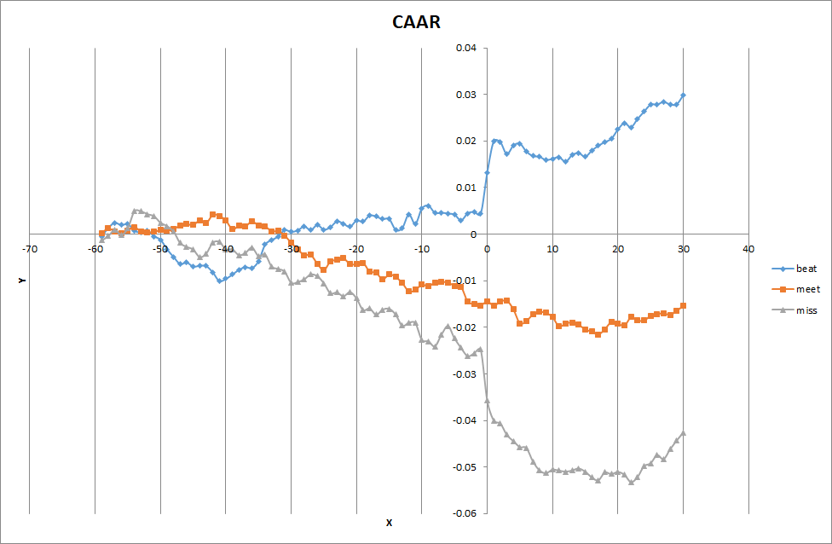
CAAR PLOT
19
Notes:
And this graph comes out like this. As you can see from this chart, the releasing of expected EPS has an impact on the stock price.

Slide 26
CONCLUSION
Beat | Steep increase
Meet | Marginal effect
Miss | Steep decrease
The difference of CAAR among the three groups has been widen greatly after the announcement.
We can conclude that the releasing of the earnings do has an impact on the stock price.
20
Notes:
The blue curve represents the group “Beat”, which experiences a steep increase on the announcement date. And after releasing date, it keeps improving.
The orange curve represents group “Meet”, the CAAR has no significant change on the announcement date, stay at a certain level, still following its own previous trend.
The grey curve indicates group Miss, the CAAR experiences a steep decrease on the announcement date. In about ten days after announcement date, it keeps declining.
And we can also tell that the difference of CAAR between the beat and miss groups has been widen greater and greater after the announcement.
Thus we can conclude, if the actual EPS is similar to the estimation like stocks in group meet, the releasing has only a marginal effect on the stock price. But for stocks of group beat and miss, their price would experience a dramatic change after the announcement.

Slide 27
Reference
S&P500. (SPY) (2017). Profile, business summary. Yahoo! Finance.
Retrieved from https://finance.yahoo.com/
Bloomberg. Bloomberg Professional. (2017)[Online]. Available at: Subscription
Service (Accessed: 28 November 2017)
Prata, Stephen. C++ primer plus. Sams Publishing, 2002.
21

Slide 28
THANK YOU!

